Slide 1
GROUP 1
Hardika Bhasin
Naitik Gada
Aishwarya Kale
https://github.com/HardikaB/GAHackathon2

Slide 2
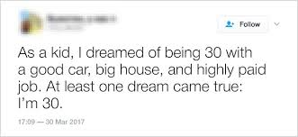
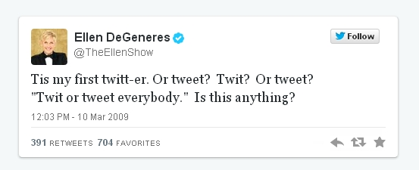
Problem Statement :
Sarcastic or Non-Sarcastic tweet
Build a machine learning model that, given a tweet, can classify it, correctly as sarcastic or non-sarcastic.
Key challenges with tweet data
a) Unclean data
b) Ambiguity
c) Lack of facial expressions
d) Lack of voice Modulation
e) Different Languages.
@Greyatomtweet , Its a SIMPLE problem of supervised
classification with no DATA. #sarcasm

Slide 3
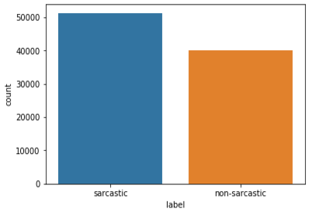
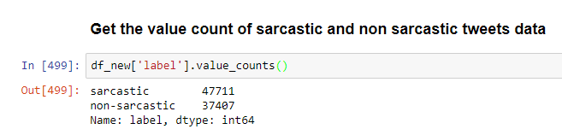
EDA
Given Data :
1) ID : Unique ID of tweet
2) Tweet : Tweets to be classified as sarcastic / non sarcastic.
3) Label : Sarcastic and non-sarcastic.

Slide 4
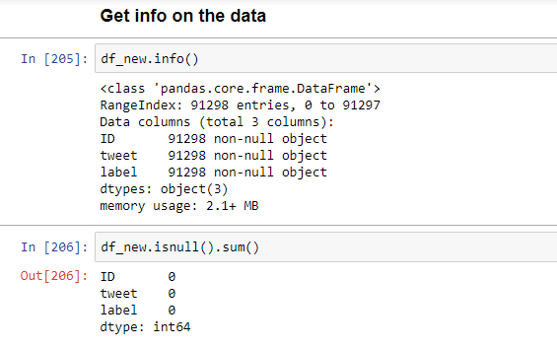
Missing values

Slide 5
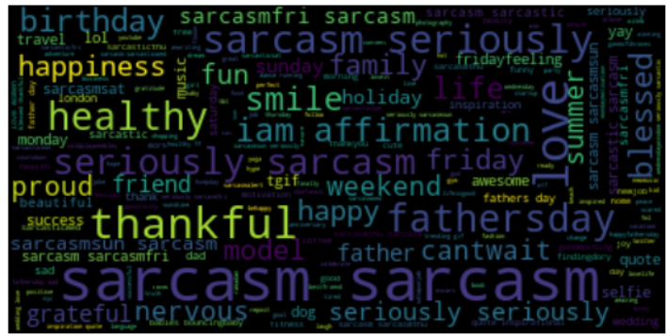
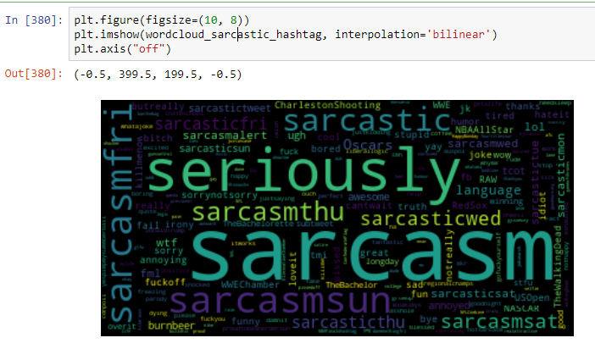
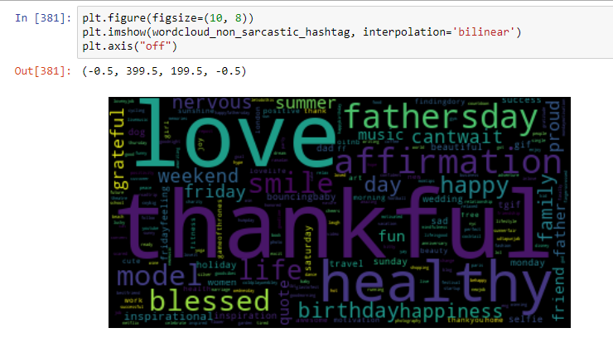
Word Cloud
Top_sarcasticwords=['sarcastic','Oscars','language','wtf','lol','fml','awesome','ugh','annoyed','sorrynotsorry','yay','funny','thanks','fail','pissed','sorry','RAW','idiot','sad','bitch','TheWalkingDead’]
Top_Nonsarcasticwords=['thankful','love','healthy','affirmation','fathersday','model','blessed','smile','life','happy','birthday','happiness','cantwait','weekend','family','proud','grateful']

Slide 6
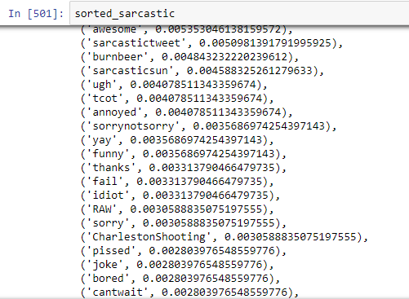
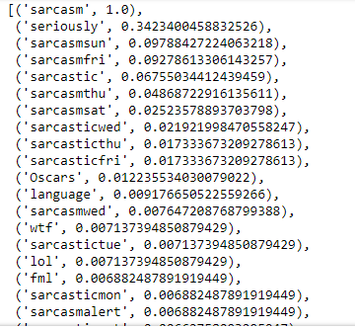
Sarcastic Top #Words

Slide 7
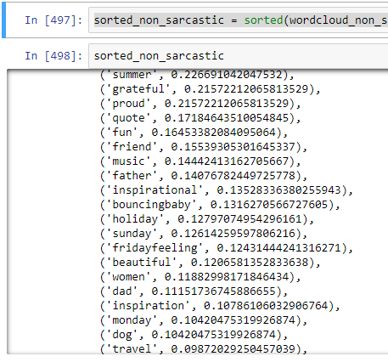
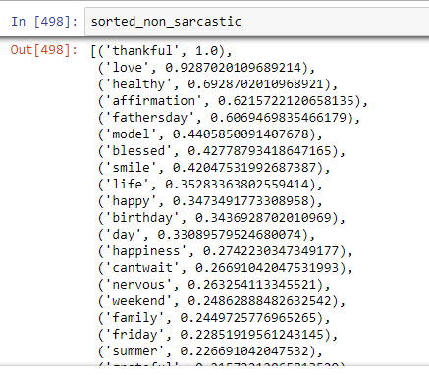
Non Sarcastic #Words

Slide 8
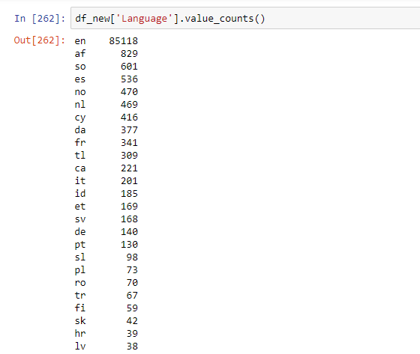
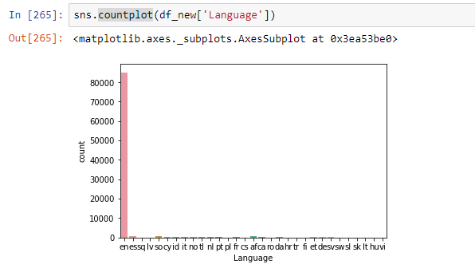
Cleaning Data
Cleaning of non – English Words.

Slide 9
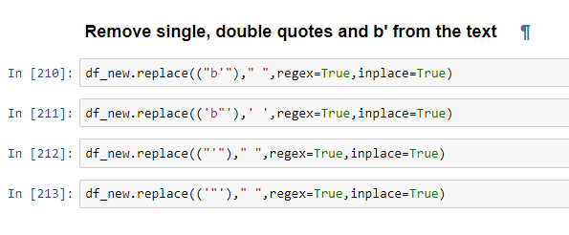
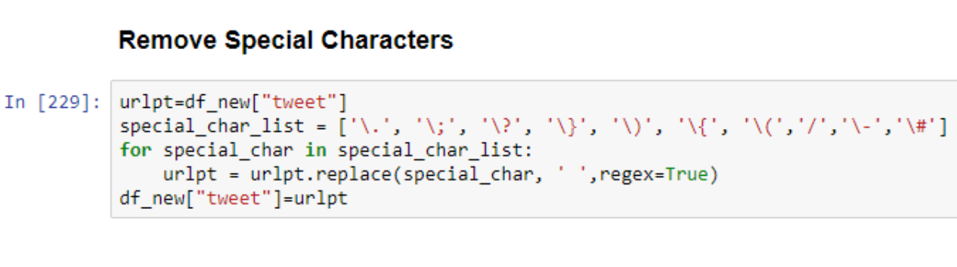
Removing Special Characters

Slide 10
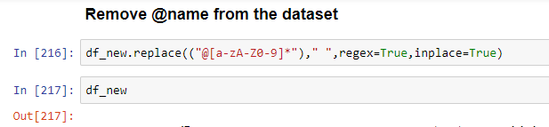
Removed Usernames

Slide 11
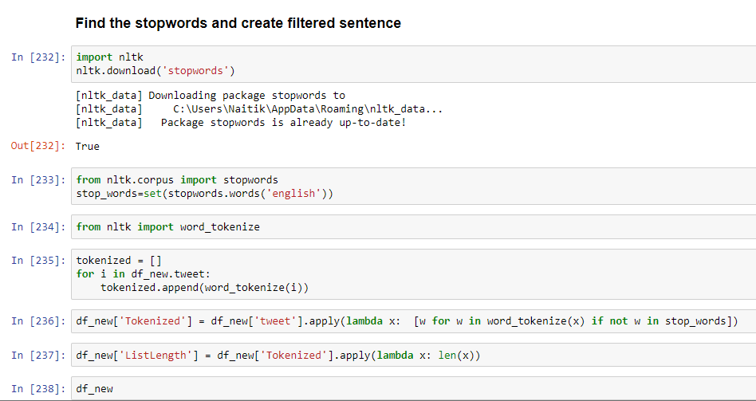
Stop Words

Slide 12
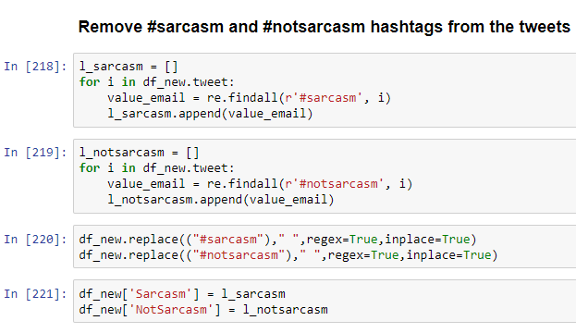
Removed #Sarcasm words

Slide 13
Feature Modelling
Lexical vector
Number of capital Letters
Number of functional Words
Number of Slangs
Number of hash tags
Number of Top Hash Tag Sarcastic Words
Number of Top Hash Tag Non-Sarcastic Words
Number of Positive words in tweet
Number of Negative words in tweet
Lexical Popularity

Slide 14
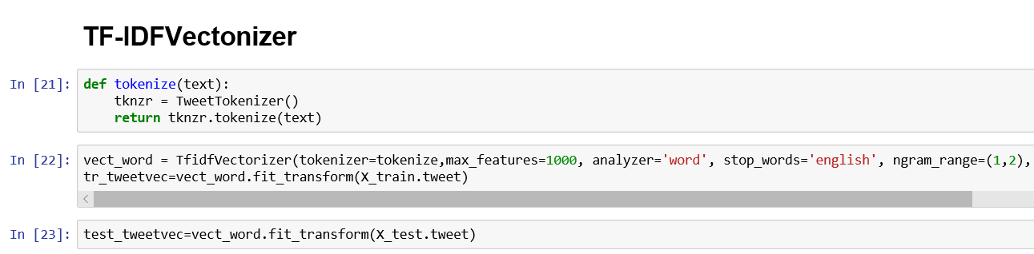
Lexical Words
Cleaned tweets
Stemming
Tokenized
Unigram and bigram
TF-IDF vectorization

Slide 15
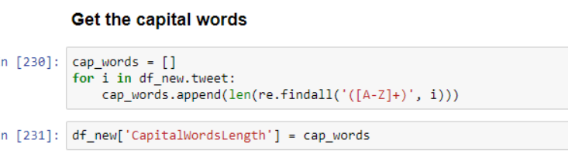
Number of Capital Letters
Count of Capital Words:
Captures the trend effect of capital words in tweet.

Slide 16
Number of functional Words
Count of cleaned and tokenized words :
Captures tweet length trend.

Slide 17
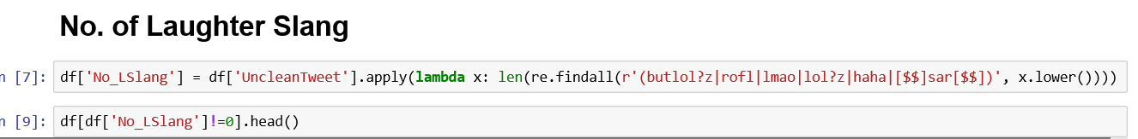
Number of Slangs
Slangs like LOL,ROFL,HAHAHA

Slide 18
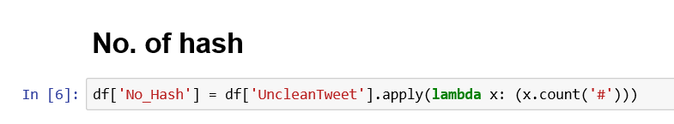
Number of hash tags

Slide 19
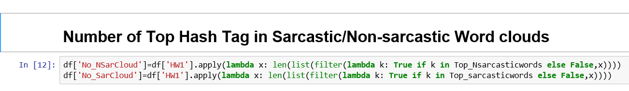
Count of Top Hash Tag Sarcastic/NonSarcastic Words
Extracted Hash Tags
Created Word cloud for sarcastic tweets
Picked most occurring Tags
Created columns with count.

Slide 20

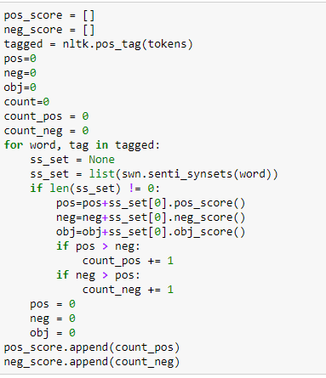
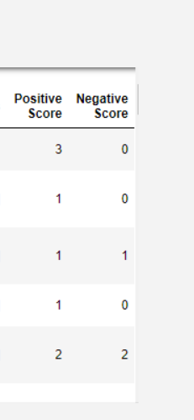
Number of Positive and negative words in tweet
Tokenized tweets and removed stop words
Applied POS tagging
Used sentiWordnet to
Sentiment across words
Counted +iv ,–iv
words in tweet.

Slide 21
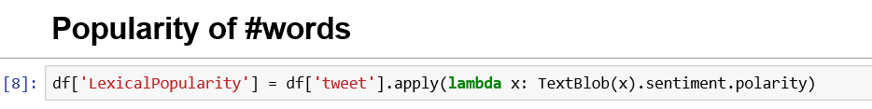
Lexical Popularity
Used TextBlob to determine the popularity of sentiment.

Slide 22
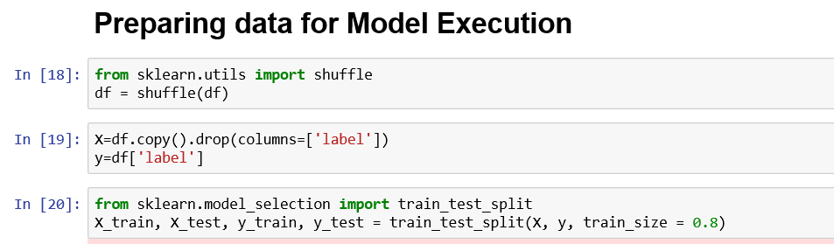
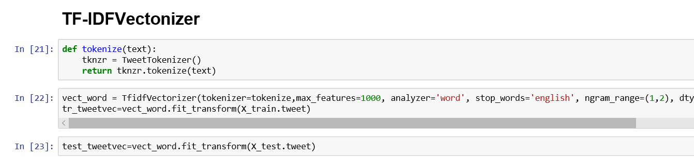
Final Data Prepration

Slide 23
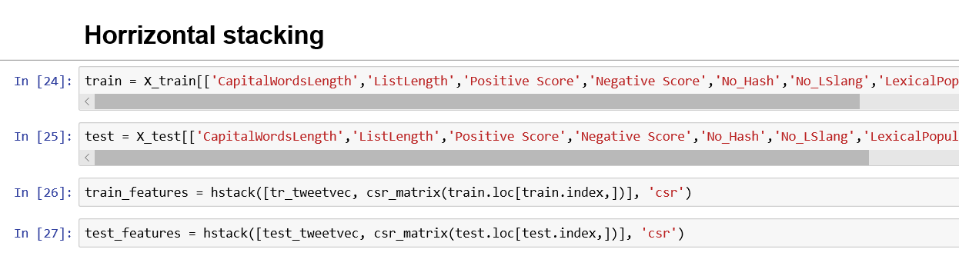

Slide 24
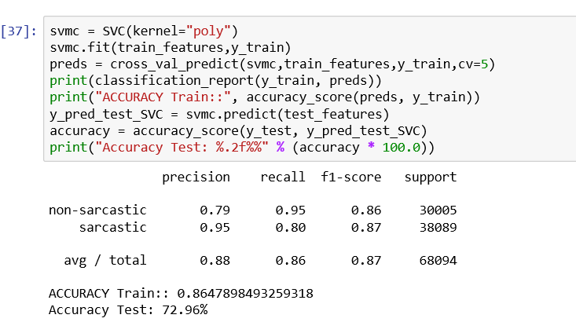
First Model Iteration
Without language cleaning
Lexical vector
Number of capital Letters
Number of functional Words
Number of Slangs
Number of hash tags
Lexical Popularity

Slide 25
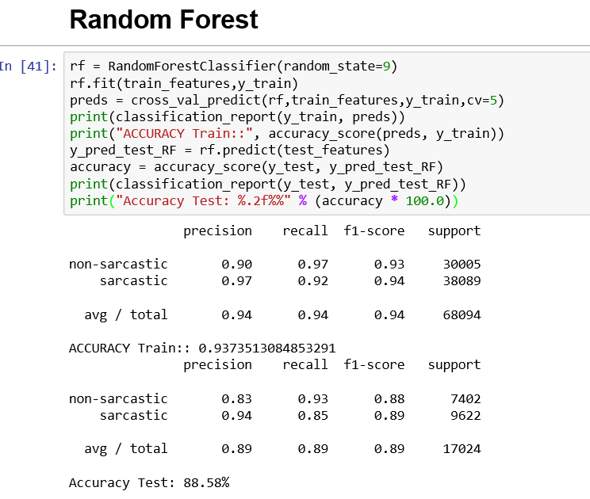
RandomForest

Slide 26
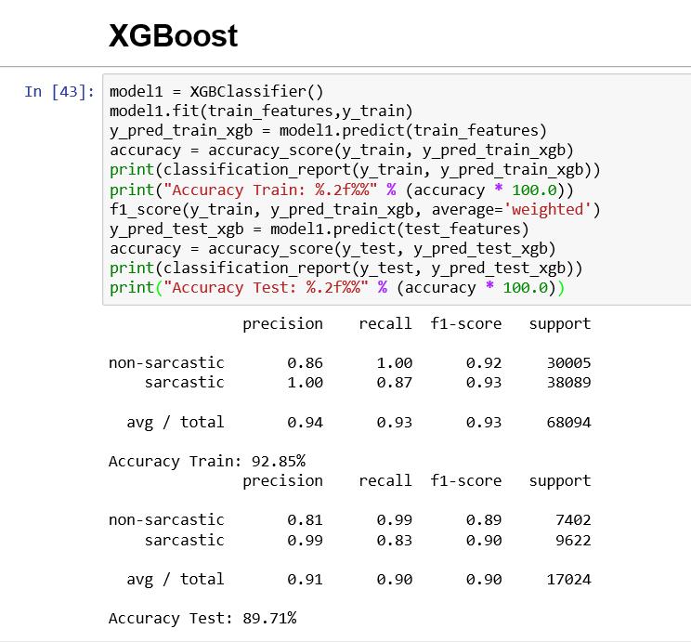
XGBoost

Slide 27
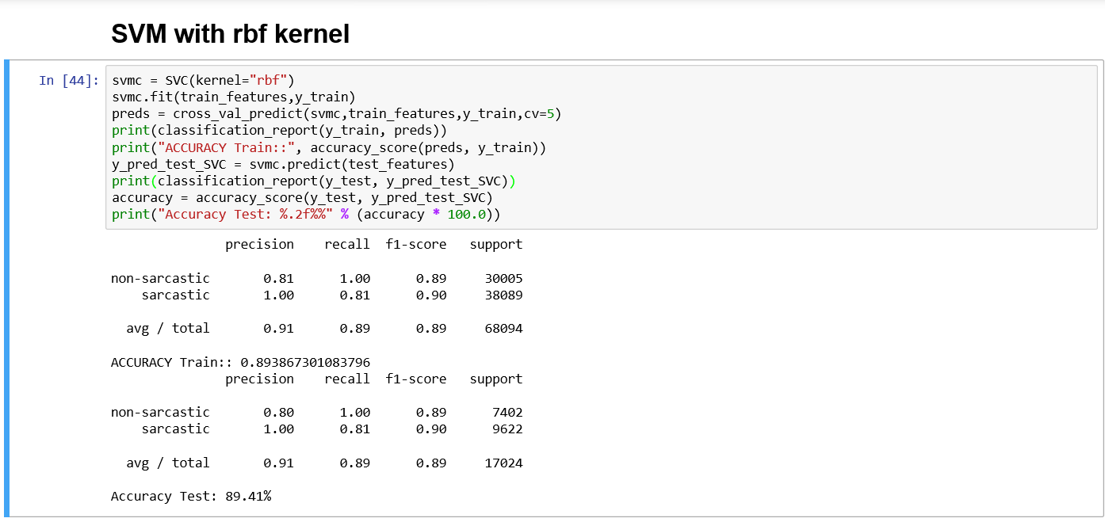
SVM with rbf kernel

Slide 28
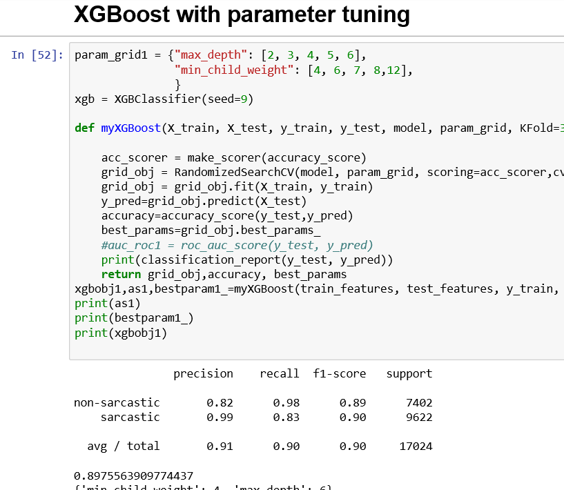
XGBoost with parameter tuning

Slide 29
Conclusion
Final Approach XGBOOST
Ensemble Modeling can be done.
Seemed data was really small. Like
Each user detail :: Patter for a user prediction
Content or tweet trail :: Could have used Topic Modelling
Thank you

